Slide 1

Travel
Brigham Young University
College of Nursing

Slide 2
Paying for Travel
Travel Allowance
  $1700 total for travel expenses for calendar year (flight, hotel, food, etc)
  $750 total for registration for calendar year
College Account
  Represent college with prior approval of the Dean
  Faculty who are on elected boards of regional or national nursing organizations and need to attend the annual conference will be supported in their efforts. Check with the organization to see if travel funding is available for board members. Presentations at these conferences are encouraged.
  Professional/Business meetings and/or mileage for faculty/staff are supported based on position responsibilities. Travel for faculty who are asked by the college to attend special meetings will be covered in addition to the individual faculty travel budget.
Research Account
  Research dissemination
  Conducting research, data collection, working with external team, etc.

Slide 3
Travel Cards
Faculty are issued a BYU credit card
When your card expires, the ASB will contact you when your new card is ready for pick-up.
  The Undergraduate Secretary or Financial Assistants are available to pick up your card for you from the ASB
  If you pick up your own card, be sure to bring it by the Undergraduate Secretary/Assistant Controller’s desk to make note of updates to the card
The billing address for all travel cards is C-40 ASB

Slide 4
Getting Started
Submit a travel application on the college website at least 2 months before your trip
  Make sure you have money in your account before submitting a travel application. Ask Kathy, Delsa, or the financial assistants for help if needed.
  The form will need to be approved by Dean Lassetter. Delsa will use the information on the form create a Travel Authorization through Chrome River which is then approved by Kathy. Once we have both approvals, Delsa will start arranging your trip.

Slide 5
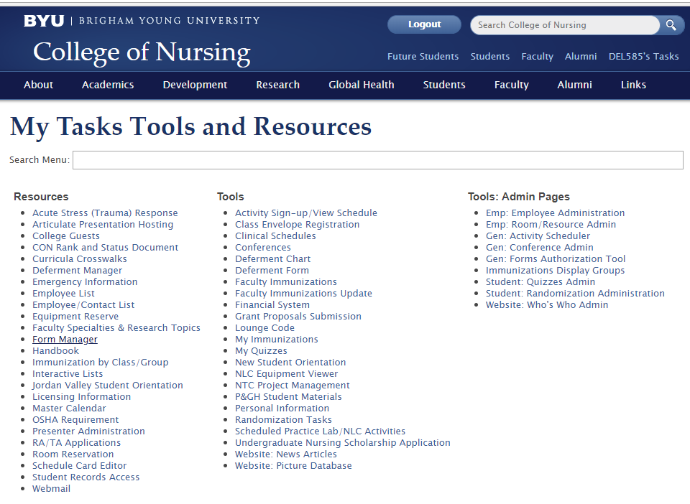
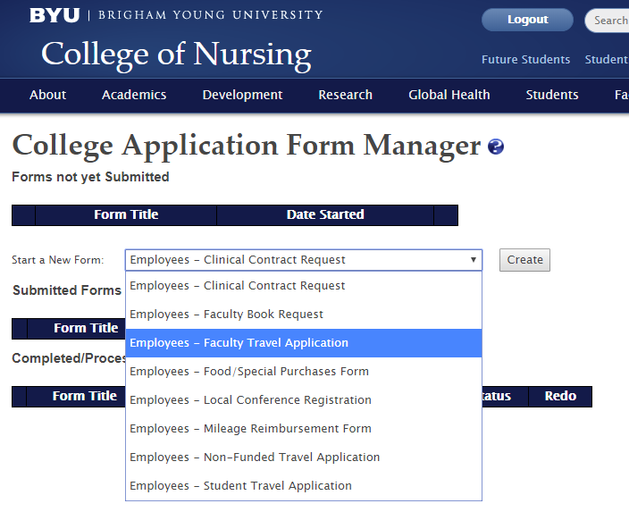
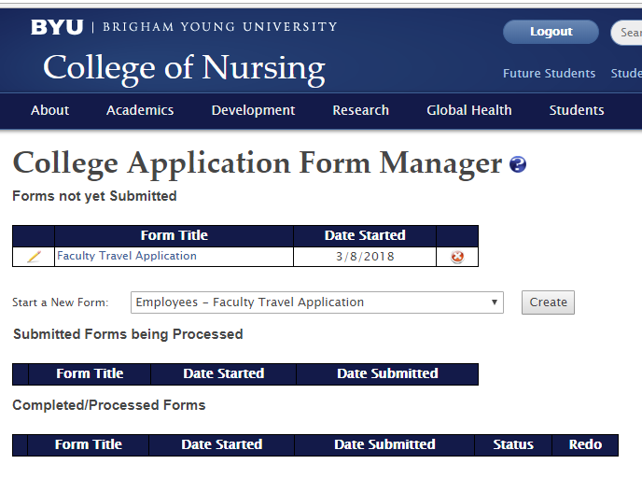
Filling Out a Travel Form
Under Resources, Select Form Manager
Start a New Form, Select Faculty Travel Application from the drop down menu, click Create
Click on the pencil icon to edit TA
Validate and Submit after completing the form

Slide 6
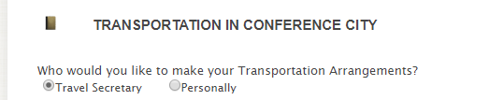
Make sure all of your dates match up (flight and hotel check-in and check-out)
Make sure the flight date and times are correct. Unless it is an emergency, the cost to change a flight is $200 plus any difference in the flight cost
Your estimated number of meals should take into account any meals provided by the hotel or conference
For things that you mark that you will complete “personally,” please follow through on this.
On the other hand, if you mark “travel secretary,” please don’t make reservations personally without letting me know first.

Slide 7
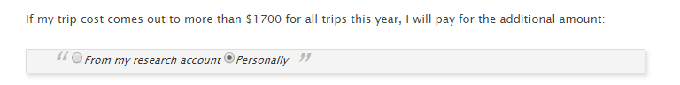
Paying for Overages
Don’t forget to mark this section at the end of the form (for any trips paid for through your travel allowance): If you don’t mark this area, the default mode marks that you will pay any overages personally. You will mark this section once at the top of the form and once at the bottom.

Slide 8


Hotel
After approval, the first thing I do is book your hotel.
We always try to get you into the conference hotel if possible.
The college will pay through the duration of the conference, and up to the night before and the night after the conference.
If you are staying at a hotel where there is not a lower conference rate (things like research trips, meeting with donors, etc.) we can still have the Travel Office see if BYU is contracted with them to get you a cheaper rate.
Conference hotels fill up quickly. Procrastination often leads to higher costs.

Slide 9
Conference Registration
You may check out a purchasing card and register yourself for a conference (after approvals) or the financial assistants can register you.
Do this as soon as possible to get the early bird rates!
Email the financial assistants for help: admserv@byu.edu
  Be prepared with
    Logins/usernames/passwords
    Session preferences (if applicable)
    Meal preferences (if applicable)
    Emergency contact
    Title & Credentials

Slide 10
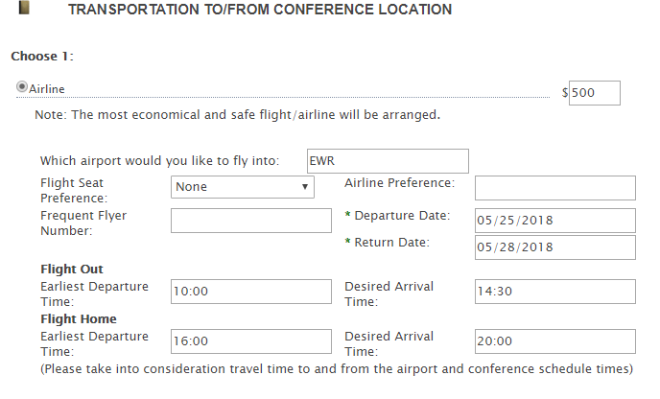
Flights
I will price out flights using the dates and times you put on your travel application. I will verify your flight with you before I book it. Any changes after booking may result in a flight change fee of $200 plus difference in airfare.
I will
Try to get the cheapest flight (this may include a layover)
Try to get you to your destination before dark.
Do not book your flight yourself!

Slide 11
Conference City Transportation
We will always try to find the cheapest modes of transportation.
The college will pay for transportation between the airport and hotel using:
  Shuttles
    usually the cheapest, some hotels have free shuttles
    Do not use Shuttlefare.com (cards have been compromised using their site)
    We typically use SuperShuttle.com
  Taxis
    Best for large groups (2 or more people)
  Rental Cars
    Must use Hertz, National, or Enterprise or BYU rental cars (if driving from Provo)
    You will be reimbursed up to what the cheapest mode of transport would have been
    Refill fuel on rental cars before returning to company to avoid fees.

Slide 12
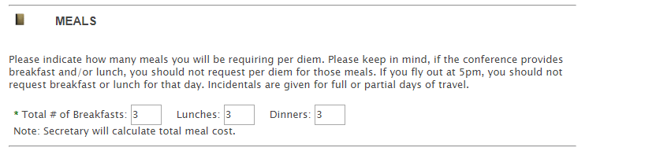
Meals
The college will pay up to the per diem rate for the city to which you are traveling for your individual meals.
You will need to pay personally if you go over the per diem rate for the city to which you are traveling.

Slide 13
Receipts
Submit ITEMIZED receipts that list out what was purchased to Chrome River via the Snap app or email to receipt@ca1.chromeriver.com. They will be loaded into your ChromeRiver account and Delsa will be able to complete your expense report.
  Make sure the email address you send the receipts from is linked to your Chrome River account.
  Please label your receipts as much as possible (ex: Friday breakfast, taxi ride to hotel)

Slide 14
Missing Receipts / Non-Itemized Receipts
If you are unable to get a complete receipt, fill out a Missing Receipt Form
  Include:
    Description of what was purchased
    Why you were unable to get an itemized receipt
    What steps you took to get an itemized receipt (ex: called/emailed the vendor)
  The form will need to be signed by yourself and Kathy

Slide 15
Travel Binder/Folder
I will create a travel binder/folder for you at least 1 week prior to your trip. It will contain flight, hotel, registration, and any other pertinent information to your trip.
I recommend putting receipts in the folders in case the digital images don’t work.
Please double-check any confirmations the financial assistants or I send you.

Slide 16
Family
You must personally reimburse the college for any charges for family members accrued on your travel card.
If possible, please try to pay for family meals on separate cards. If you can’t do that, mark what each person had so I know which is college and which is personal.

Slide 17
Student Travel
Sponsoring faculty will fill out a Student Travel Application on the college website at least 8 weeks prior to domestic travel.
All travel should be with a faculty.
If the student has inflexible conflicts with the proposed travel itinerary and the faculty still deems it necessary for the student to attend, send them to Delsa to fill out the Student Travel Authorization as soon as possible! We need to get it approved by Risk Management.
The college will pay for the following:
  Hotel
  Flight (plus one bag)
  Meals (some choose to have students pay for their own meals to help them be more invested in the conference )
  Transportation between the airport and hotel
The college will not pay for the following (not even from a research account):
  Transportation to the SLC Airport or within the conference city (other than between the hotel and airport)
  Airport parking

Slide 18
Cancelling/Changing Trips
Try not to do this
Major cancellation fees – registration, flights, hotel deposits, etc
If you are unsure about your plans for a conference, it is best to wait until you have all of your information together before you submit the form.

Slide 19
Foreign Travel
Visit travelsmart.byu.edu prior to filling out a travel application; See if your location is on the restricted list
For many foreign trips, it’s often a good idea to take cash because there are lots of places that don’t accept credit cards.
BYU does not pay for “acclimation time” if you are traveling over the dateline. The same rules still apply—the max BYU pays is the night before the conference, through the conference, and the night the conference ends for you to come home the next day.
Global Health travel is managed through the Kennedy Center.

Slide 20
Cash Advances
This may only be used for Foreign Travel for trips of 7 days or more, with a minimum amount of $500.
The cash advance must be requested on the travel authorization. This means that you cannot let us know a week before your trip that you need a cash advance. So when you put in your travel application a few months before your trip, include in the notes section how much you need and why.
Still use your travel card whenever possible.
Leftover cash should be returned to the travel office.

Slide 21
Local/Virtual Conferences
If you are attending a virtual or local conference, fill out the Local Conference Registration form

